Slide 1

Outland Adventures | CSSP -
Case Study Solution Presentation
Presented by : Maddison Montijo | Fernando Contreras Corzo | Oscar Avina | Jordyn Rylander | Desarai Lofton

Slide 2

Case Study Overview
About Outland Adventures
Opened by two outdoor enthusiasts, Blythe Timmerson and Jim Ford - Outland Adventures arranges trips, will provide* equipment, and have guides for aspiring adventurers.
However, there are a few aspects of their business they needed taken care of.
Equipment Sales
Equipment Rentals
Booking Trends
Equipment Deterioration

Slide 3
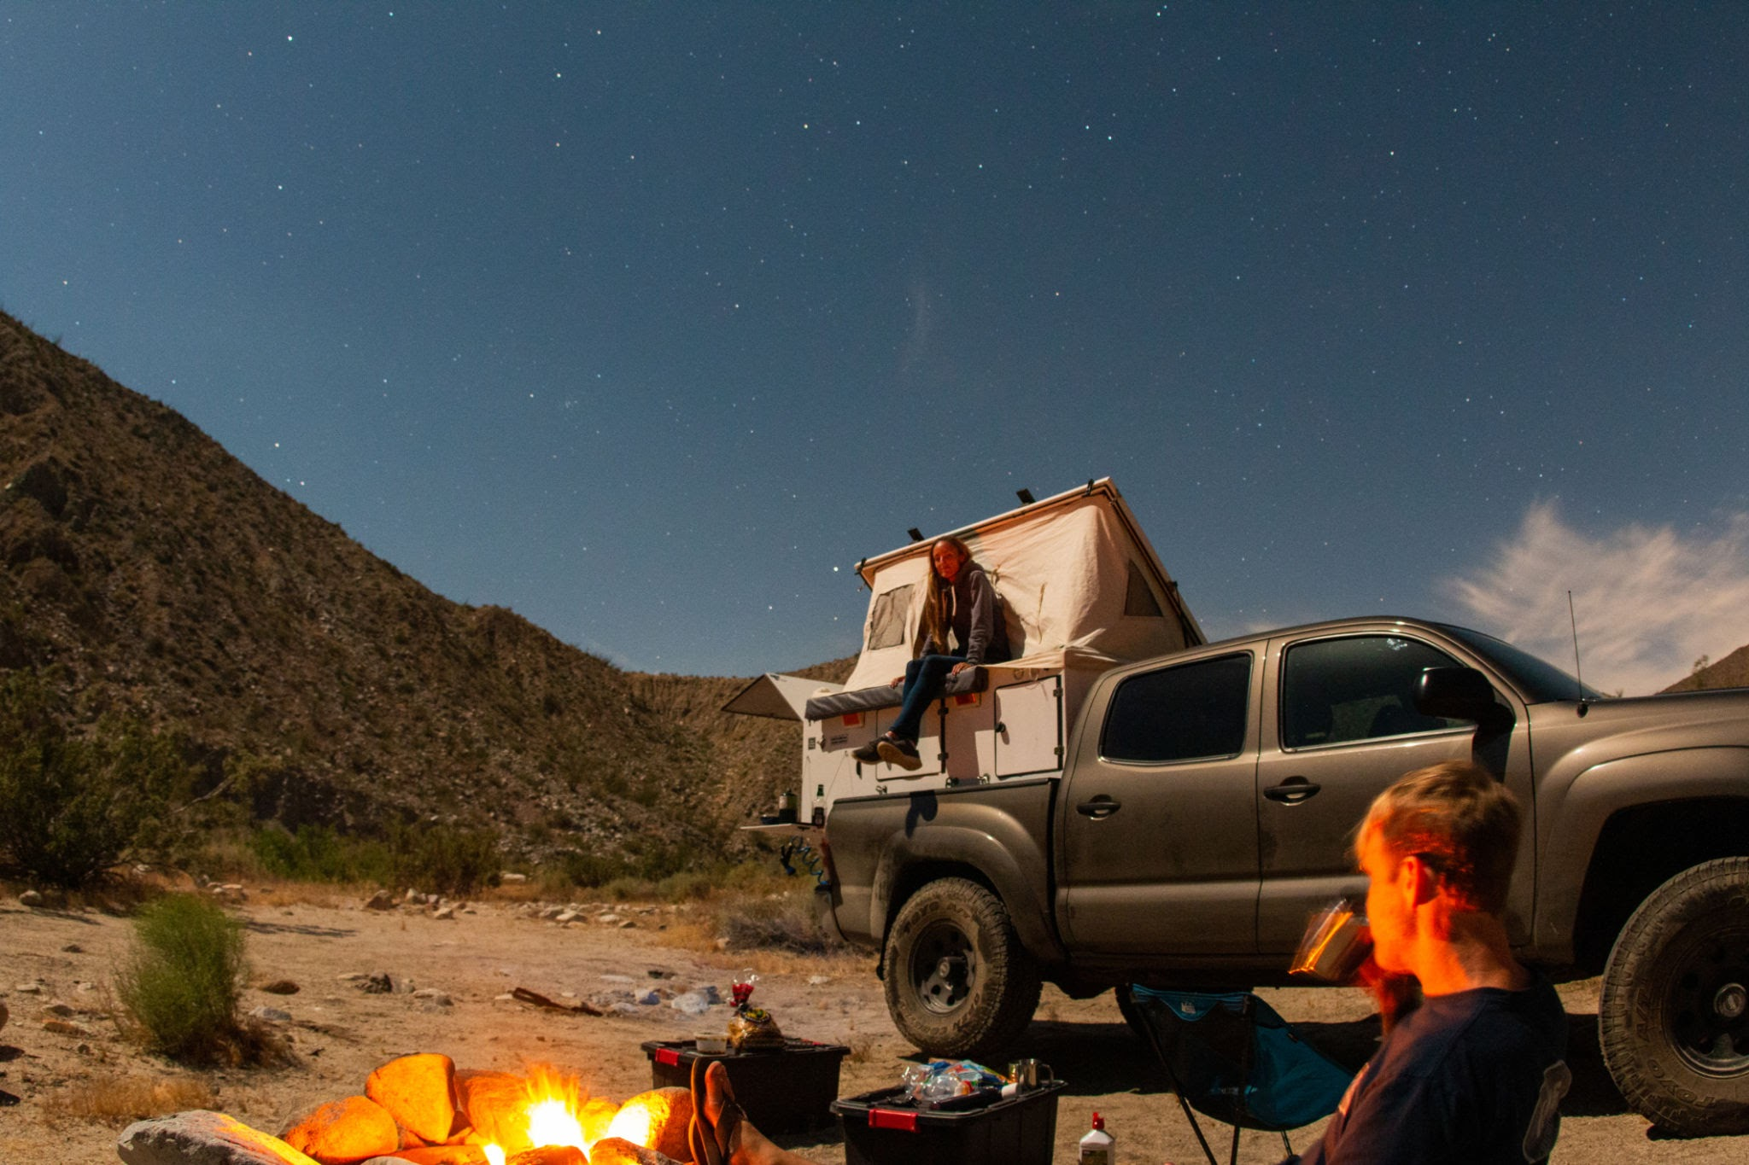


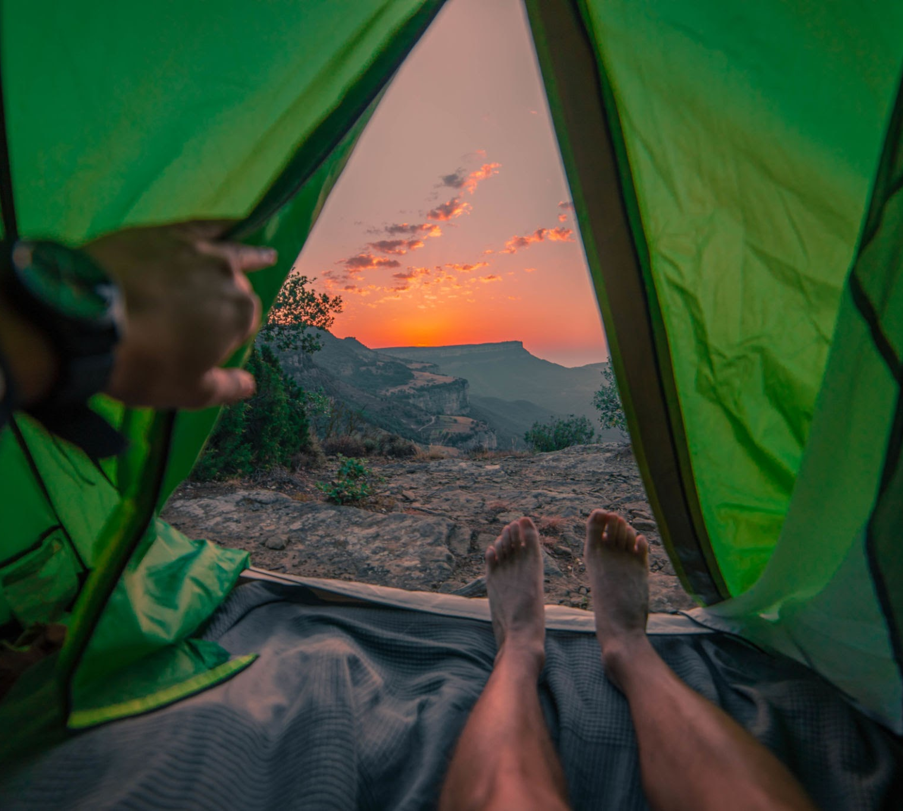



Slide 4

Group Intro
Hello We’re The Green Team! Aiming to optimize Outland Adventures data tracking and business needs.
Maddison Montijo
Fernando Contreras Corzo
Desarai Lofton
Role | Junior Software Developer
“Whatsup Team!”
Role | Experienced Software Developer
“Let’s go team!”
Role | Experienced Software Developer
“Hey Ya’ll!”
Oscar Avina
Jordyn Rylander
Role | Experienced Software Developer
“Hey team!”
Role | Junior Software Developer
“Hi team!”

Slide 5
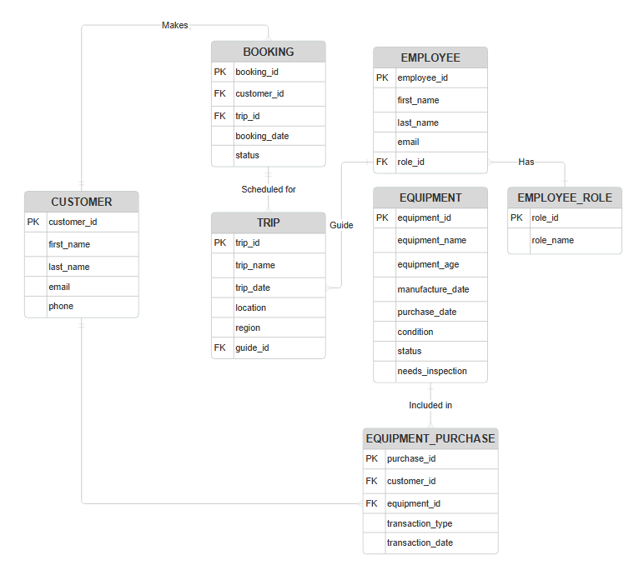
Entity Relationship Diagram
TABLES
Booking
Customer
Employee
Employee Role
Equipment
Equipment Purchase
Trip

Slide 6
Table Relationships
Equipment Purchase to Equipment
Customer to Booking
Customers making the bookings.
Equipment metadata is included in Equipment Purchase
Booking to Trips
Employee to Employee Role
Bookings are scheduled for trips.
Employee have Employee Roles
Customer to Equipment Purchase
Customers makes equipment purchase

Slide 8
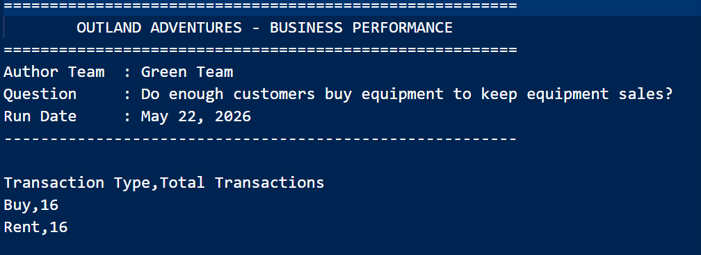
Report 1: Equipment Purchases vs Rentals
Business Question: Do enough customers buy equipment to keep equipment sales?
The creation of tables like the Equipment table and the Equipment_Purchase table help identify Outland Adventures' business concerns, such as whether equipment sales are profitable.
Economically, equipment that is in poor condition, has no sales, and is not being rented should be discontinued. This will ensure quality assurance for Outland Adventures customers and help boost reviews.

Slide 9
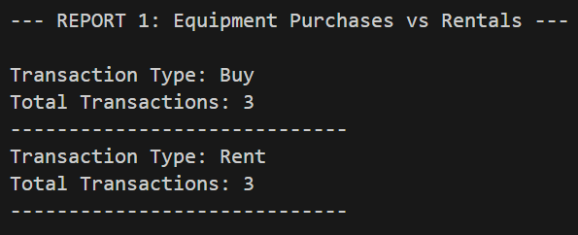
Report 1: Equipment Purchases vs Rentals cont.
Business Question: Do enough customers buy equipment to keep equipment sales?
This report counts the total_transactions and the transaction_types of each purchase.
In this case, there is an equal amount of purchases for renting and buying, in this scenario, Outland Adventures has no reason to discontinue renting out equipment.

Slide 10
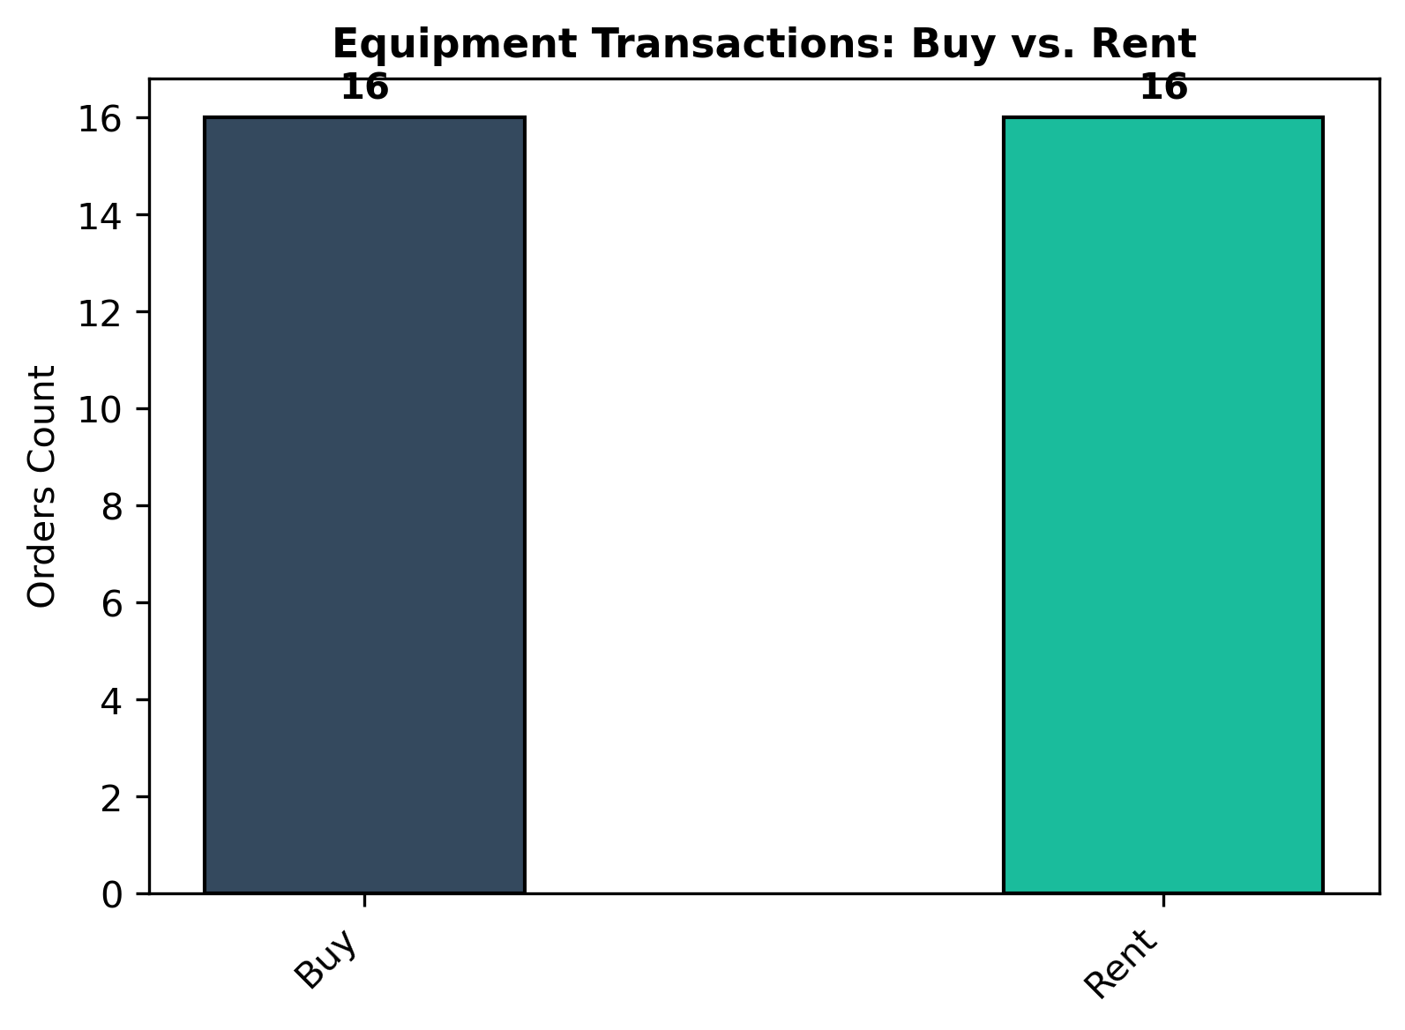
Report 1: Equipment Purchases vs Rentals Fig. 1

Slide 11

MONTH 20XX

Slide 12
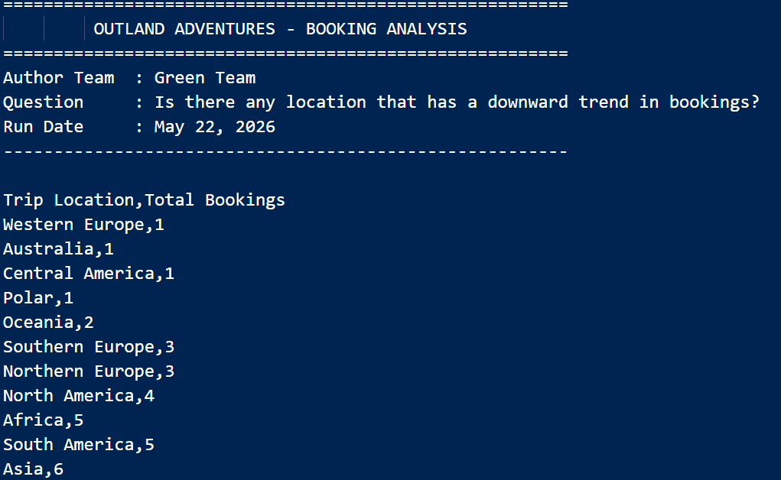
Report 2 : Trip Booking Trends

Slide 13
Report 2: Trip Booking Trends
Business Question: Is there any location that has a downward trend in bookings?
This report displays trip booking totals by location. The purpose of this report is to help Outland Adventures identify which locations may have lower booking trends.
By joining the Trip and Booking tables and grouping by location, management can see which destinations — Western Europe, Australia, Central America, and Polar — are receiving the fewest bookings and may need additional marketing attention or could be removed from the schedule.

Slide 14
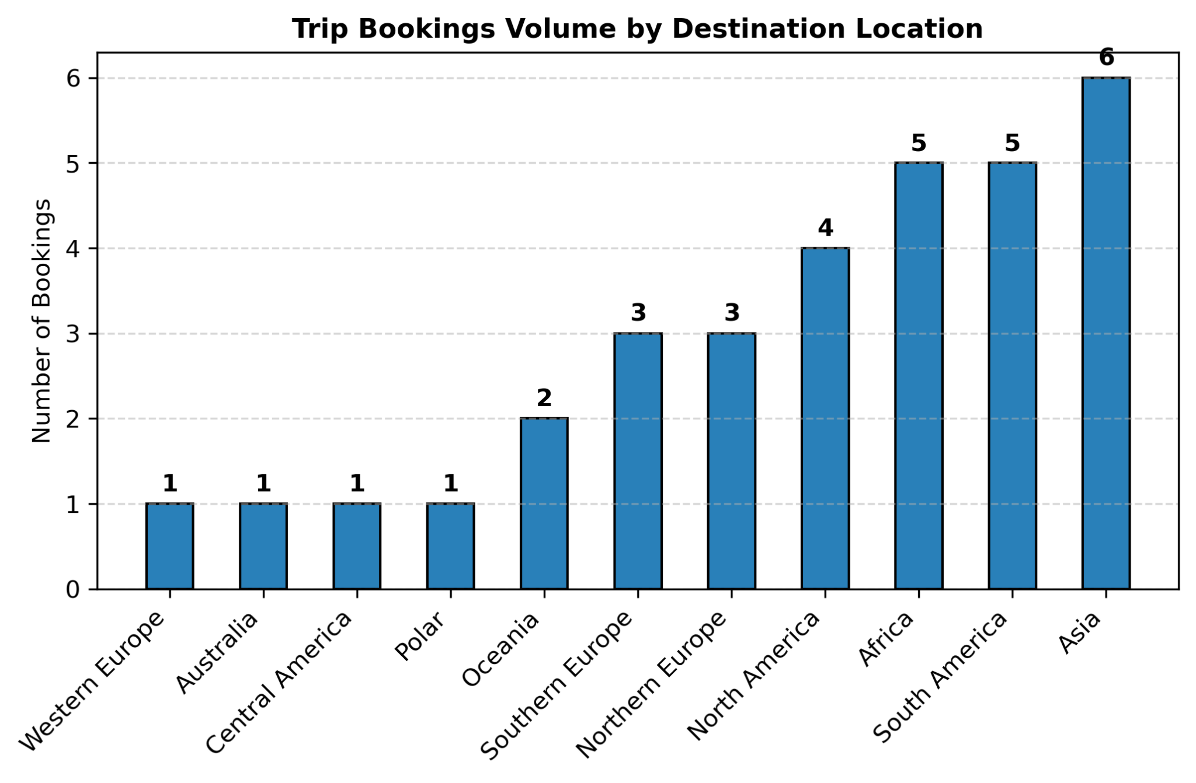
Report 2 : Trip Booking Trends Fig. 2

Slide 15
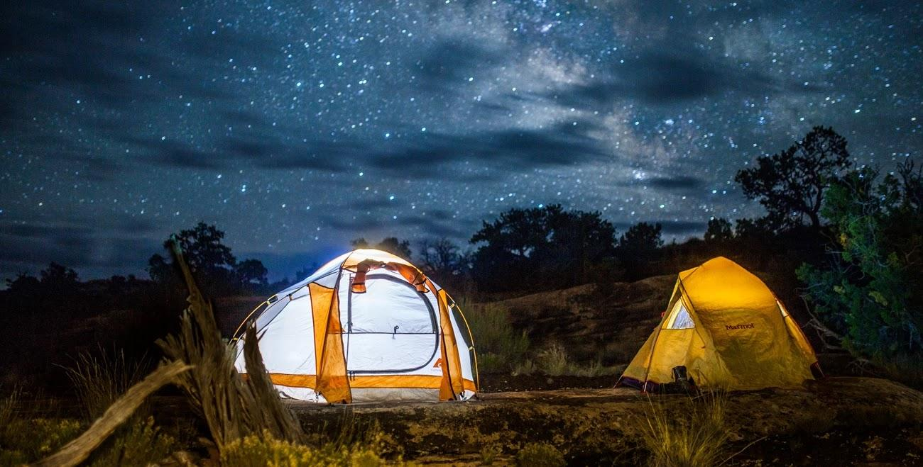

Slide 16
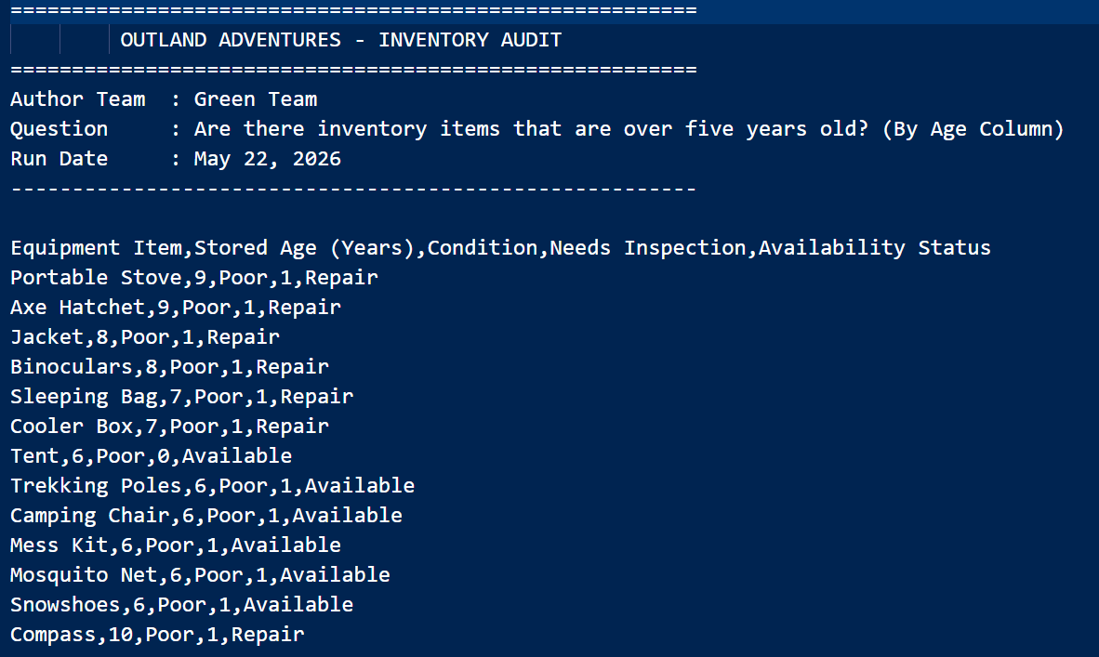
Report 3: Equipment Older Than 5 Years

Slide 17
Report 3: Equipment Older Than 5 Years
Business Question: Are there inventory items that are over five years old?
This report identifies equipment that is older than five years. The purpose of this report is to help management determine whether older inventory should be inspected, replaced, or tagged before being used on future trips.
Equipment age is calculated from the equipment_age field in the Equipment table, and only items exceeding 5 years are returned in the results.

Slide 18
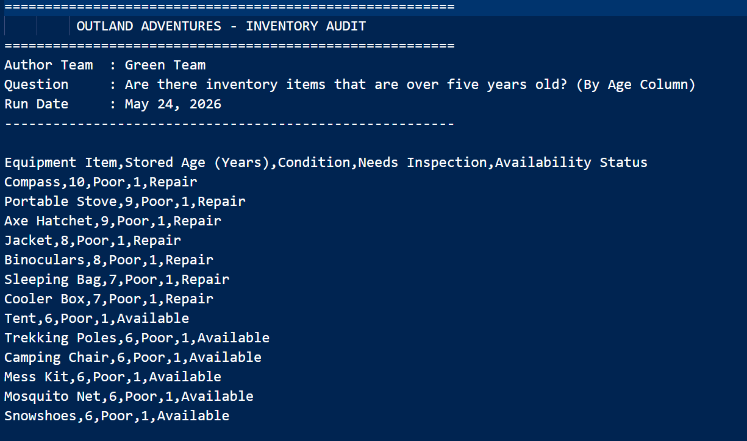
Report 3: Equipment Older Than 5 Years cont.
Business Question: Are there inventory items that are over five years old?
This report showcases a litany of older equipment all marked for inspection and needing repair.

Slide 19
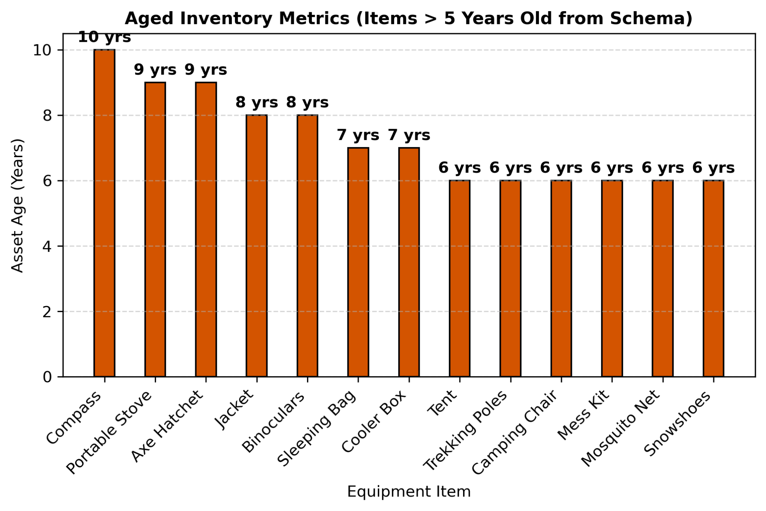
Report 3: Equipment Older Than 5 Years Fig. 3

Slide 20

Design Assumptions
The SQL database design for Outland Adventures assumes a relational structure with entities for customers, employees, guides, trips, locations, bookings, inventory, equipment sales, and rentals.
Trips are linked to regions such as Africa, Asia, and Southern Europe, while customers can book trips and rent or purchase equipment.

Slide 21
Design Assumptions
Inventory records track item age, quantity, and status to identify outdated equipment over five years old.
Sales and rental transactions support analysis of equipment profitability.
Booking data allows trend analysis by destination.
Employee roles are separated into administration, marketing, guides, inventory management, and ecommerce operations to support efficient business processes and reporting.

Slide 22
Thank You!
CSD 310 | Milestone 3
We hoped you enjoyed our presentation!!
Green Team
Greenteam.DaBomb.Com
@GreenTeam

